Slide 1


CALCQUEST
Replacing Mathematical Stress with Fun!
Zakaria Coulibaly Pradyumna Nanduri Hammad Ahmad

Slide 2

Project Team and Advisors
The Minds Behind the Innovation
Team Members: Zakaria Coulibaly, Pradyumna Nanduri, Hammad Ahmad - A diverse team with a unified goal to transform precalculus education.
Advisory Support: Guided by Dr. Kabir, Assistant Professor, leveraging academic insights and technical expertise to refine the application's educational impact.
Collaborative Effort: A synergy of computer science and educational theory, embodying a blend of technical skill and pedagogical innovation.

Slide 3

Zakaria Coulibaly
Lead Programmer, UI/UX Design, React Native, JavaScript, Python scripting, and code maintenance.
https://github.com/levisstrauss
https://www.linkedin.com/in/codemon/
Expected Graduation: Summer 2024

Slide 4

Pradyumna Nanduri
Programmer, specializing in JavaScript, Database Management (MongoDB), and project organization.
https://www.linkedin.com/in/prad-nanduri/
Expected Graduation: Spring 2024

Slide 5

Hammad Ahmad
Database Architecture, JavaScript and Web Development, SQL, management, brainstorming, and presentation.
https://www.linkedin.com/in/hammad-ahmad-5334551b8/
https://sgtrocket786.github.io/sgtrocket.github.io/
Expected Graduation: Fall 2024

Slide 6

Precalculus Mastery Mobile Application
CALCQUEST: A Comprehensive Overview
Educational Paradigm Shift: Introduces gamified learning to precalculus, engaging students with rewards for academic achievements, enhancing motivation and comprehension.
Comprehensive Curriculum: Covers essential precalculus concepts such as trigonometry, functions, and complex numbers, designed for in-depth understanding.
Cross-Platform Accessibility: Developed with React Native, ensuring seamless use across various devices, enabling learning anytime, anywhere.

Slide 7

Development Process
From Conception to Launch
Idea Inception: The project began with a vision to make precalculus learning more engaging and accessible.
Technical Challenges: Addressing cross-platform compatibility and integrating diverse educational content into a game-based learning environment.
Solutions and Successes: Leveraged React Native for development efficiency, Firebase for real-time data management, and Contentful for flexible content delivery.

Slide 8

Comparative Analysis
CalcQuest vs Traditional Methods
Engagement and Interactivity: The app introduces gamification and interactive modules, unlike traditional textbooks and lectures.
Accessibility and Convenience: Available anytime, anywhere, on multiple devices, offering a more flexible learning schedule than classroom-based learning.
Adaptability to Learning Styles: Provides personalized learning paths, adapting to the student's pace and style, which is challenging to achieve in conventional settings.

Slide 9
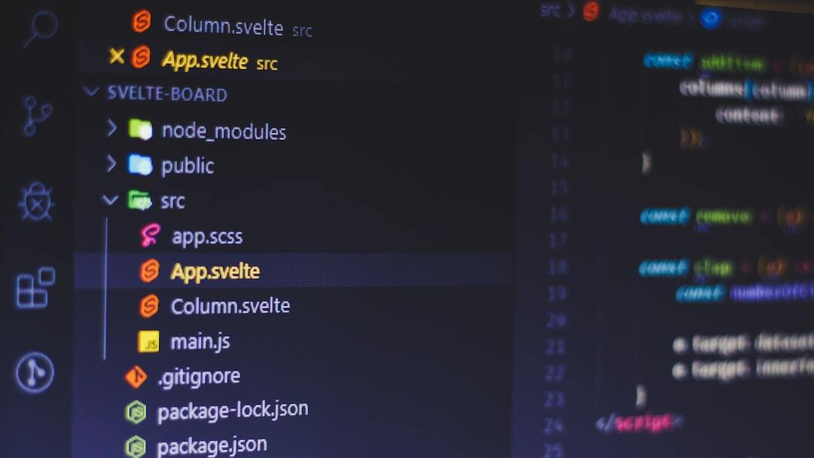
Technical Architecture
Powering Interactive Learning
React Native for Cross-Platform Use: Enables consistent user experience across iOS and Android, reducing development time and costs.
Firebase for Database Management: Provides a reliable, scalable database solution for real-time data syncing and user authentication.
Contentful for Content Management: Allows for dynamic content updates, making the curriculum adaptable and enriching the learning materials.
Latex for Quiz Generation: Combined the use of Latex - a Markup language to result in unlimited potential for question generation.

Slide 10
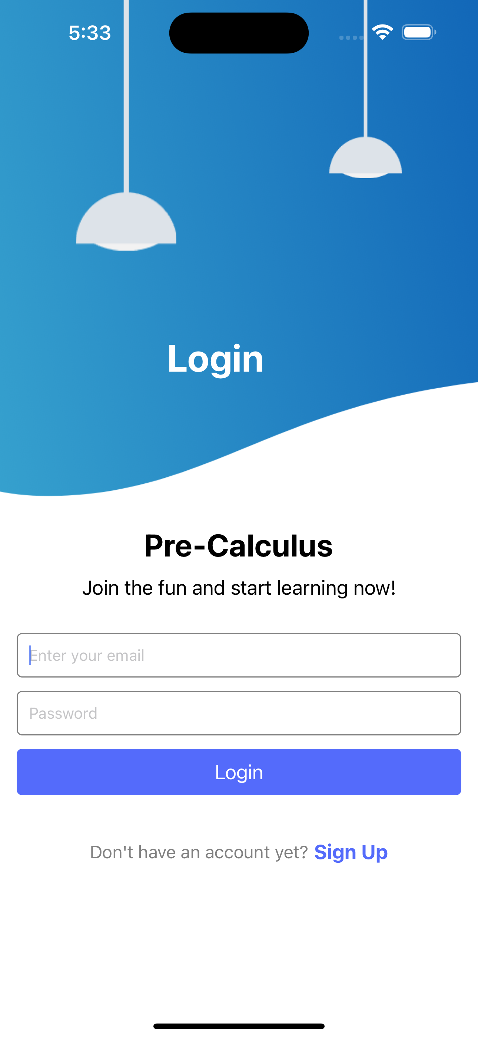
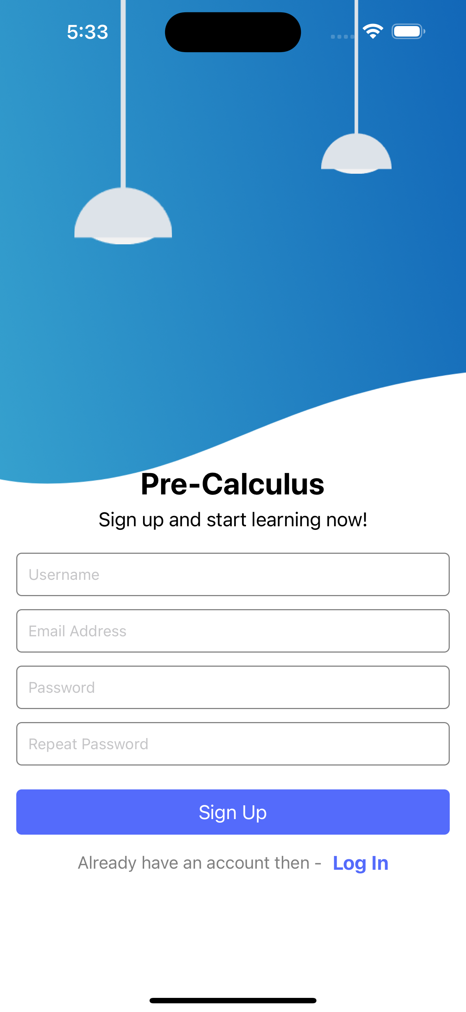
Authentication
The Welcome and Authentication feature of CalcQuest ensures a seamless onboarding experience for users.
It allows individuals to easily sign up or log in to their accounts, providing a personalized learning environment from the start.
Fully implemented authentication functionality.

Slide 11
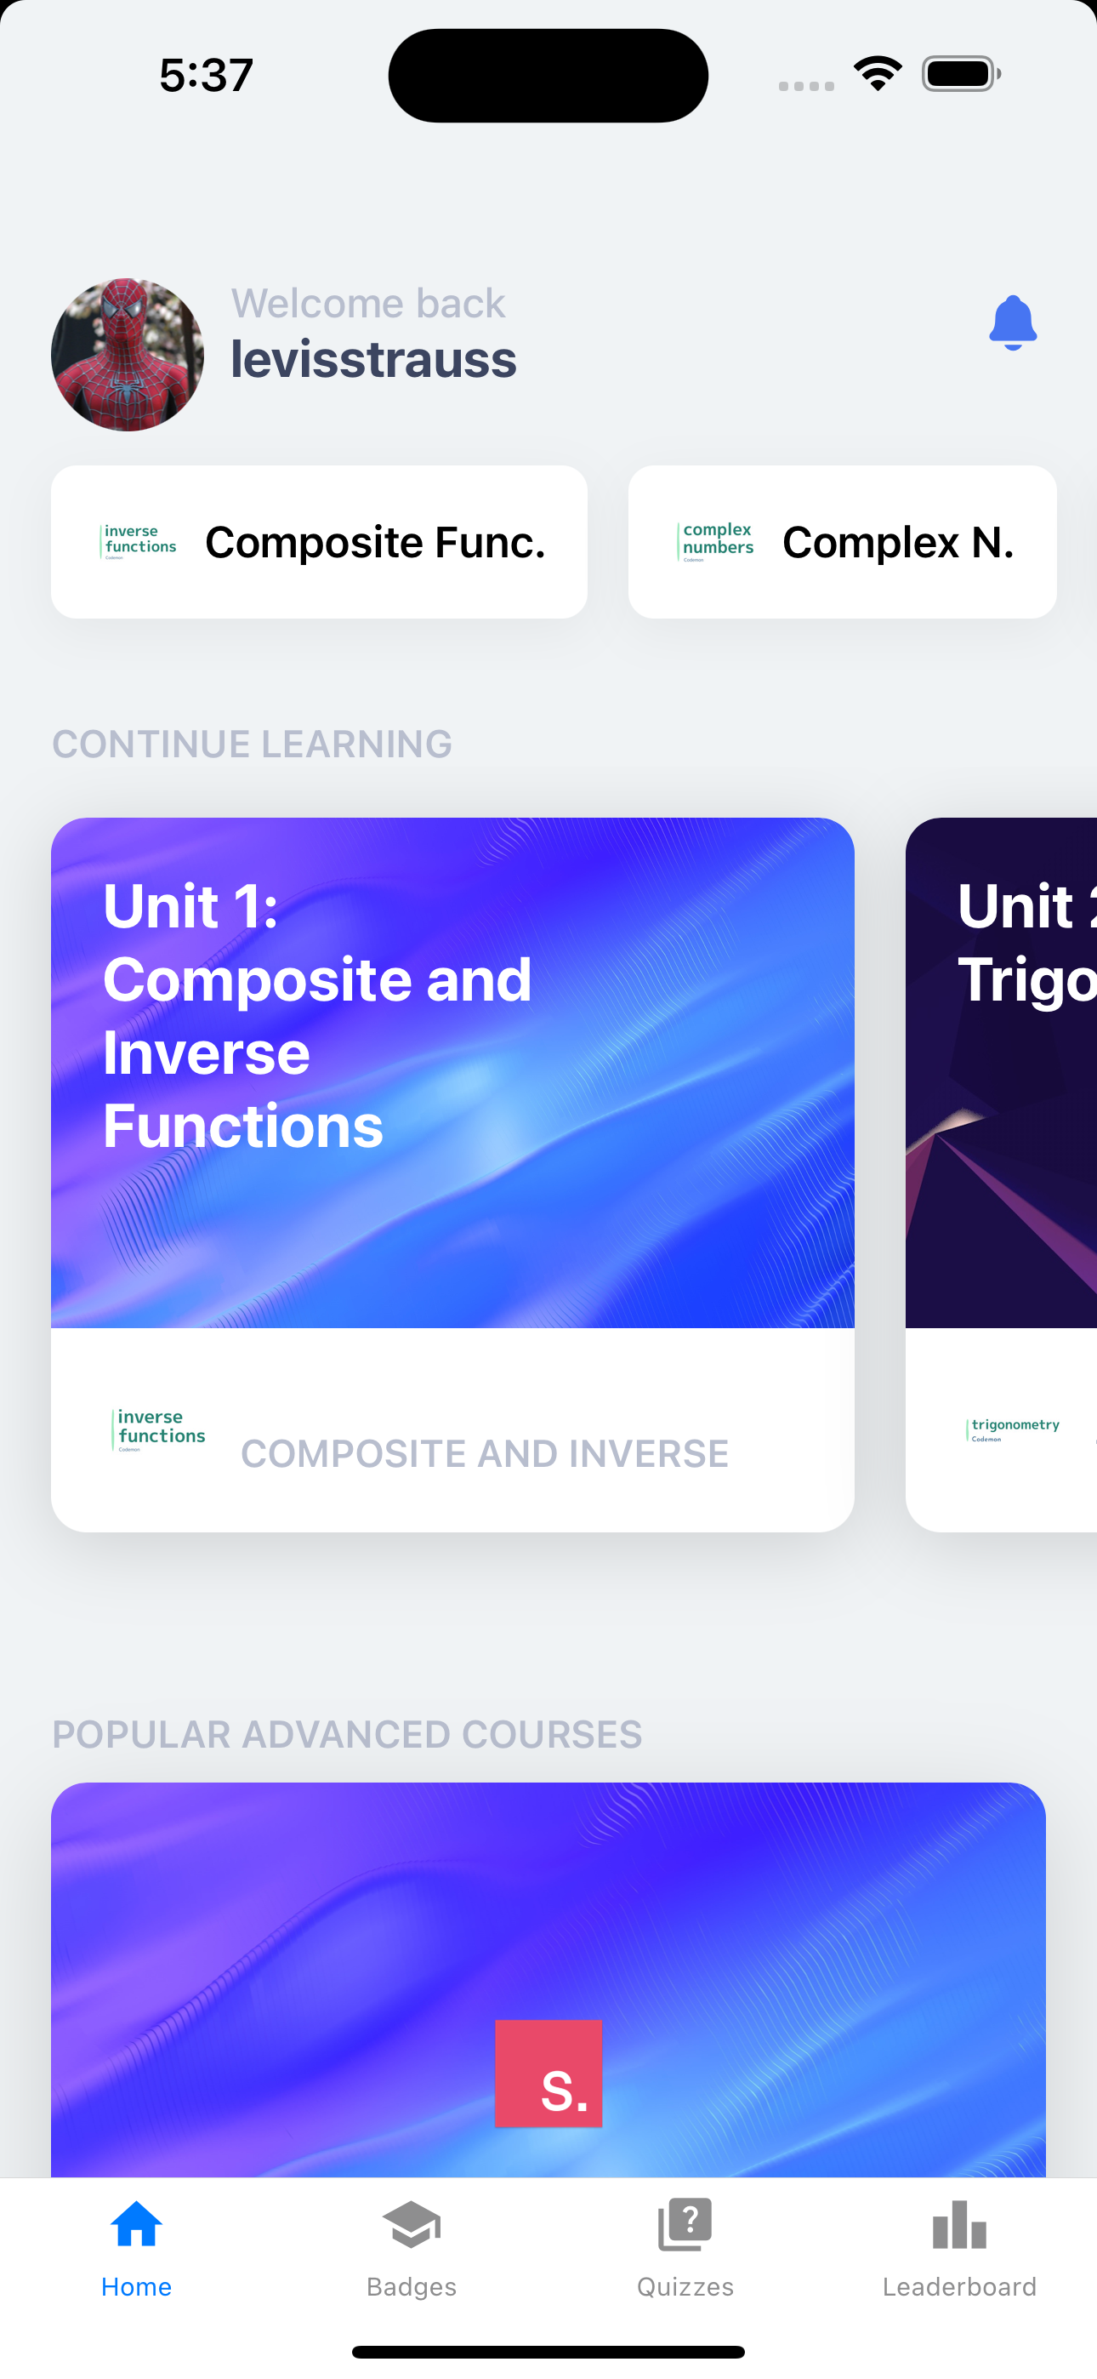
User Interface and Experience
A Closer Look at the App
Intuitive Navigation: Designed for ease of use, allowing students to seamlessly explore various precalculus topics.
Interactive Modules: Features engaging exercises and quizzes, promoting active learning and immediate feedback.
Progress Tracking: Enables users to monitor their learning journey, celebrating achievements and identifying areas for improvement.

Slide 12
Home Page
The Home Page in CalcQuest serves as the central hub for users to access all key functionalities and navigate learning journey.
From here, users can easily track their progress, explore and unlock courses, and engage with various learning tools.
Provides access to all other features.

Slide 13
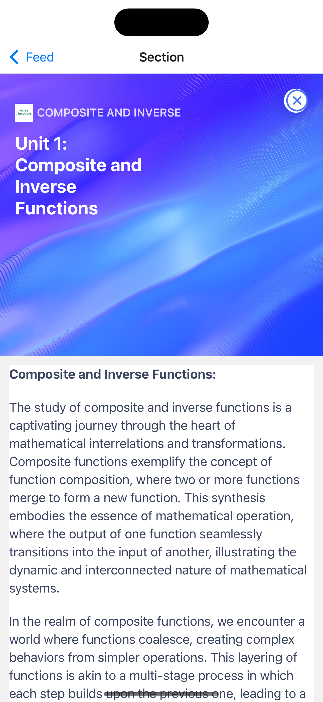
Tutorials
Pre-Quiz Tutorials provide users with essential introductory lessons before diving into full courses.
These tutorials help users grasp basic concepts and familiarize themselves with the language's fundamentals, ensuring a smoother learning experience.
Supplement to in-class learning.

Slide 14
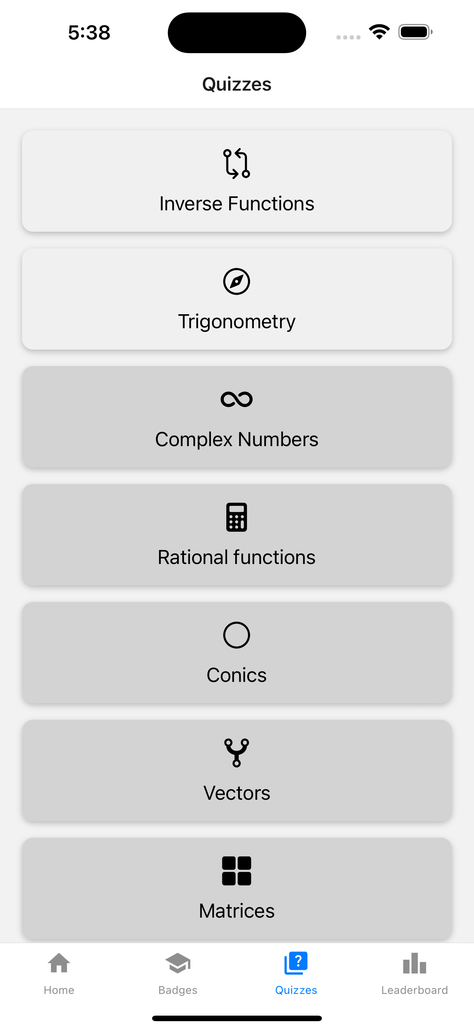
Courses
CalcQuest offers courses tailored to meet the syllabus of high-school or early College-level Pre-Calculus Courses.
Comprehensibly and sequentially tackles every aspect of Pre-Calculus.
Ensures learning is done to ensure a complete and thorough learning of Pre-Calculus.

Slide 15
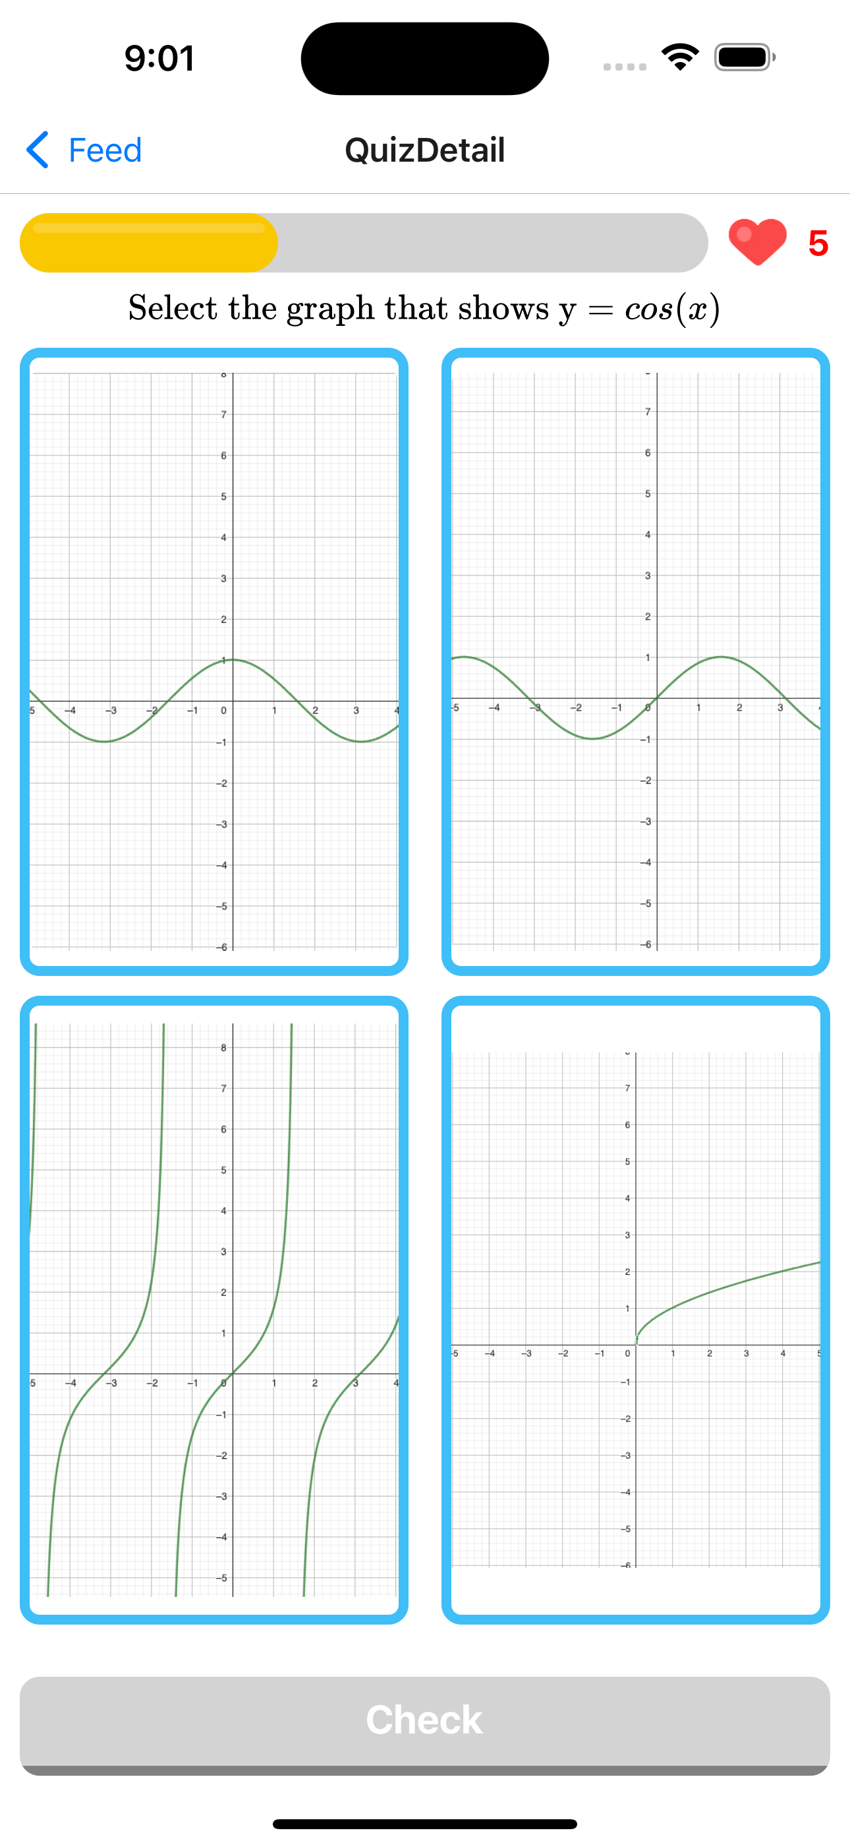
Lives and Purpose
The Lives System introduces an element of challenge and accountability to the learning process.
Users are given a limited number of lives, which are deducted with each incorrect answer during lessons. This encourages users to focus and learn more effectively.

Slide 16
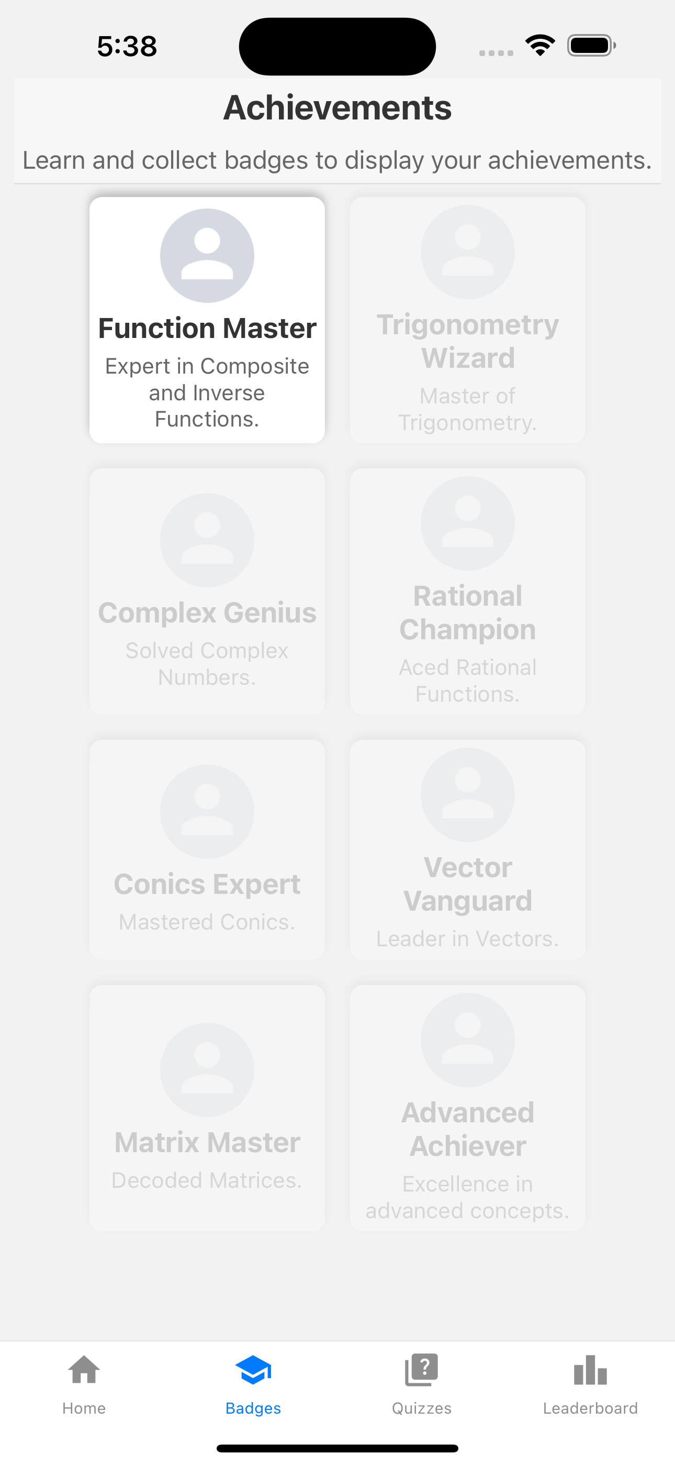
Rewards
CalcQuest's Rewards system incentivizes users to stay engaged and motivated throughout their language learning journey.
Users can earn rewards such as streak bonuses, achievements, and virtual currency by completing lessons, maintaining consistency, and achieving milestones.

Slide 17
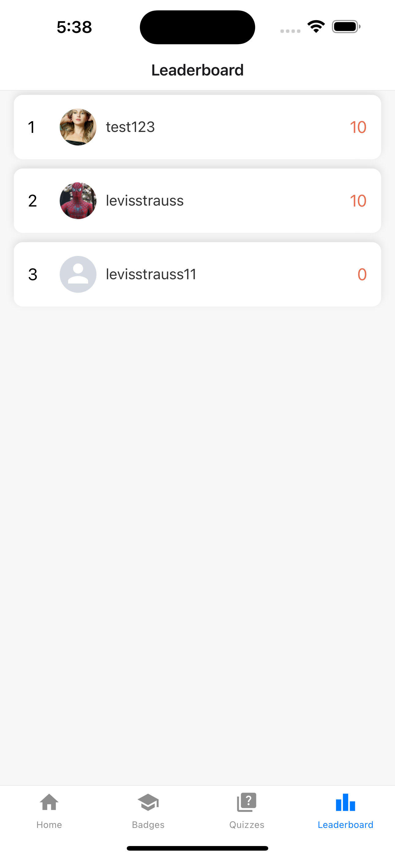
Leaderboards
The Leaderboards feature allows users to engage in friendly competition with friends and other learners.
By earning points and climbing the ranks on leaderboards, users can track their progress, compare their performance with others, and stay motivated to achieve their Math mastery goals.

Slide 18

Conclusion
Transforming Education Together
Revolutionary Learning Platform: The Precalculus Mastery Mobile Application has set a new standard in educational technology with its gamified learning approach.
Expectations from launching the application real-time:
Unified learning with a community to chat about solutions and concepts.
Badges to show and encourage competition in the community.
Adding advanced courses and concepts to challenge the user and improve the scope of the application.

